Slide 1
Neuronal Dynamics: Computational Neuroscience of Single Neurons
Nonlinear Integrate-and-Fire Model
Nonlinear Integrate-and-fire (NLIF)
- Definition
- quadratic and expon. IF
- Extracting NLIF model from data
- exponential Integrate-and-fire
- Extracting NLIF from detailed model
- from two to one dimension
- Quality of NLIF?
Week 1 and Week 4:
Nonlinear Integrate-and-fire Model
Wulfram Gerstner
EPFL, Lausanne, Switzerland

Slide 2
Neuronal Dynamics – Review: Nonlinear Integrate-and Fire
LIF (Leaky integrate-and-fire)
NLIF (nonlinear integrate-and-fire)
If firing:

Slide 3
Neuronal Dynamics – 1.4. Leaky Integrate-and Fire revisited
I=0
I>0
LIF
If firing:
u
resting
repetitive
u
u
t
t
Notes:
The LIF is characterized by a linear differential equation.

Slide 4
Neuronal Dynamics – 1.4. Nonlinear Integrate-and Fire
Nonlinear
Integrate-and-Fire
I=0
I>0
NLIF
u
u
firing:
if u(t) = then

Slide 5
Nonlinear Integrate-and-fire Model
Spike emission
j
i
F
reset
I
NONlinear
if u(t) = then
Fire+reset
threshold

Slide 6
Nonlinear Integrate-and-fire Model
I=0
I>0
u
u
Quadratic I&F:
NONlinear
if u(t) = then
Fire+reset
threshold

Slide 7
Nonlinear Integrate-and-fire Model
I=0
I>0
u
u
Quadratic I&F:
exponential I&F:
if u(t) = then
Fire+reset

Slide 8
Neuronal Dynamics: Computational Neuroscience of Single Neurons
Nonlinear Integrate-and-Fire Model
Nonlinear Integrate-and-fire (NLIF)
- Definition
- quadratic and expon. IF
- Extracting NLIF model from data
- exponential Integrate-and-fire
- Extracting NLIF from detailed model
- from two to one dimension
Week 1 and Week 4:
Nonlinear Integrate-and-fire Model
Wulfram Gerstner
EPFL, Lausanne, Switzerland

Slide 9
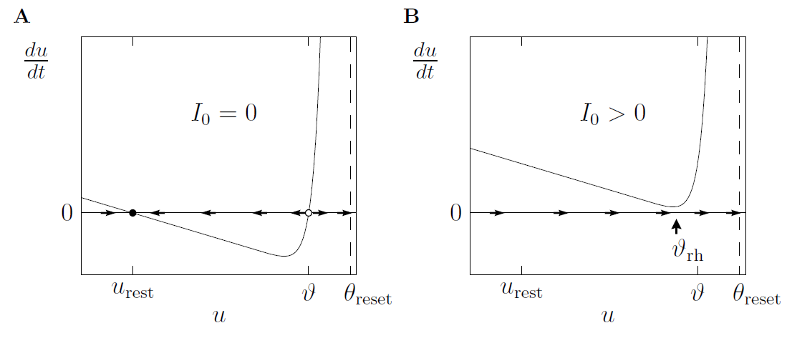
Neuronal Dynamics – Review: Nonlinear Integrate-and-fire
See:
week 1,
lecture 1.5
What is a good choice of f ?

Slide 10
Neuronal Dynamics – Review: Nonlinear Integrate-and-fire
(1)
(2)
What is a good choice of f ?
(i) Extract f from data
(ii) Extract f from more complex models

Slide 11
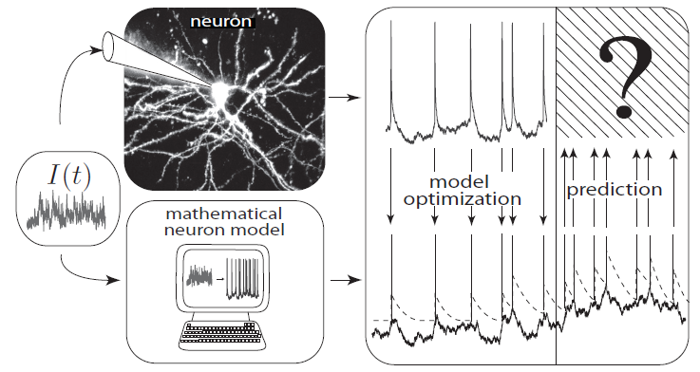
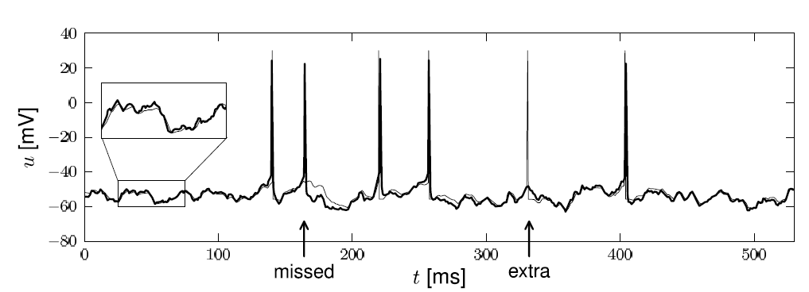
Neuronal Dynamics – 1.5. Inject current – record voltage
Notes:
What is a good neuron model? Would the nonlinear integrate-and-fire model be good?

Slide 12
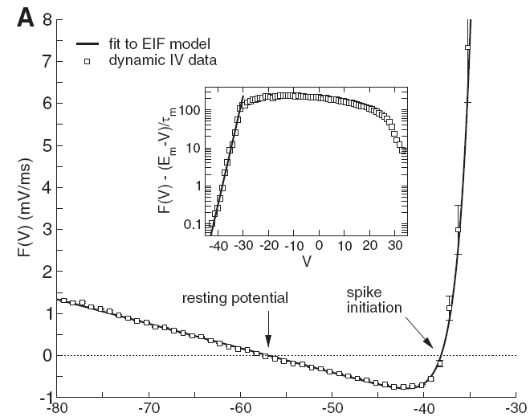
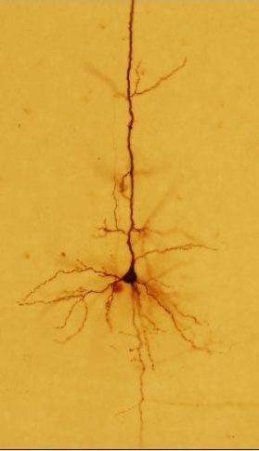
Neuronal Dynamics – Inject current – record voltage
voltage
I(t)
u [mV]
Badel et al., J. Neurophysiology 2008
Notes:
What is a good neuron model? Would the nonlinear integrate-and-fire model be good?

Slide 13
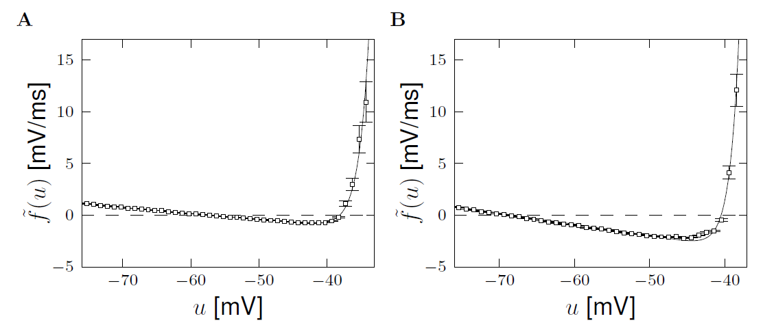
Neuronal Dynamics – Review: Nonlinear Integrate-and-fire
(i) Extract f from data
Badel et al. (2008)
Exp. Integrate-and-Fire, Fourcaud et al. 2003
Pyramidal neuron
Inhibitory interneuron
exponential
exponential
Badel et al. (2008)
linear
linear

Slide 14
Neuronal Dynamics – Review: Nonlinear Integrate-and-fire
(1)
(2)
Best choice of f : linear + exponential
BUT: Limitations – need to add
Adaptation on slower time scales
Possibility for a diversity of firing patterns
Increased threshold after each spike
Noise

Slide 15
Neuronal Dynamics: Computational Neuroscience of Single Neurons
Week 4 – part 5: Nonlinear Integrate-and-Fire Model
Nonlinear Integrate-and-fire (NLIF)
- Definition
- quadratic and expon. IF
- Extracting NLIF model from data
- exponential Integrate-and-fire
- Extracting NLIF from detailed model
- from two to one dimension
Week 1 and Week 4:
Nonlinear Integrate-and-fire Model
Wulfram Gerstner
EPFL, Lausanne, Switzerland

Slide 16
Neuronal Dynamics – 4.5. Further reduction to 1 dimension
2-dimensional equation
After reduction of HH
to two dimensions:
stimulus
slow!
Separation of time scales
w is nearly constant
(most of the time)

Slide 17
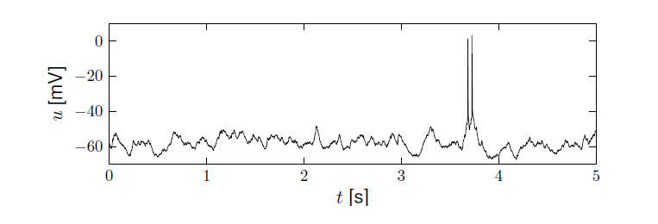
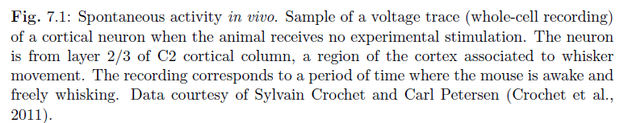
Neuronal Dynamics – 4.5 sparse activity in vivo
Spontaneous activity in vivo
awake mouse, cortex, freely whisking,
-spikes are rare events
-membrane potential fluctuates around ‘rest’
Crochet et al., 2011
Aims of Modeling: - predict spike initation times
- predict subthreshold voltage

Slide 18
Neuronal Dynamics – 4.5. Further reduction to 1 dimension
stimulus
w
Separation of time scales
I(t)=0
u
→ Flux nearly horizontal
Stable fixed point

Slide 19
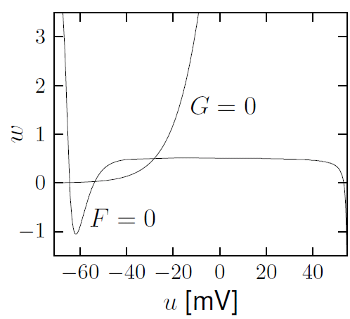
Neuronal Dynamics – 4.5. Further reduction to 1 dimension
Hodgkin-Huxley reduced to 2dim
Separation of time scales
Stable fixed point

Slide 20
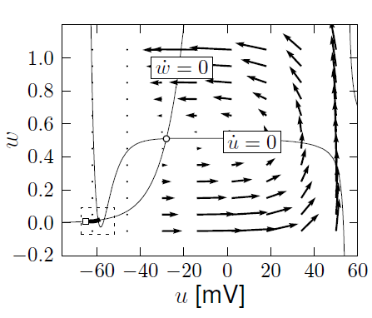
Neuronal Dynamics – Review: Nonlinear Integrate-and-fire
(i) Extract f from more complex models
A. detect spike and reset
resting state
Separation of time scales:
Arrows are nearly horizontal
Spike initiation, from rest
See week 3:
2dim version of
Hodgkin-Huxley
B. Assume w=wrest

Slide 21
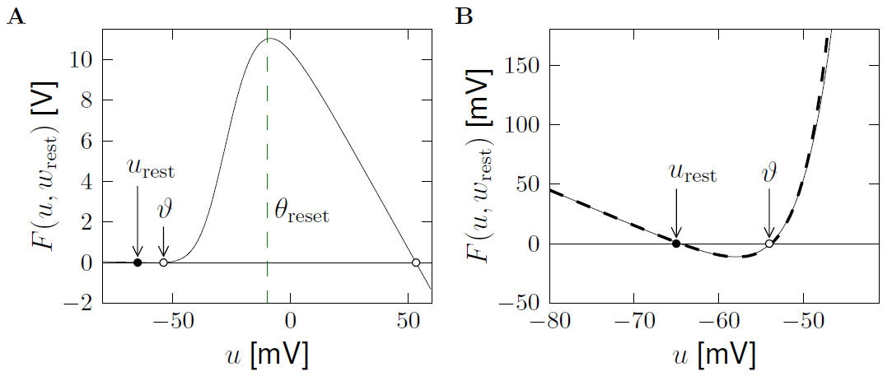
Neuronal Dynamics – Review: Nonlinear Integrate-and-fire
(i) Extract f from more complex models
exponential
linear
See week 4:
2dim version of
Hodgkin-Huxley
Separation of
time scales

Slide 22
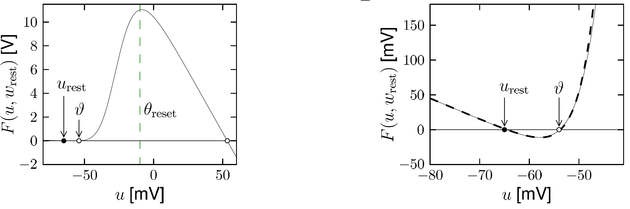
Neuronal Dynamics – 4.5. Nonlinear Integrate-and-Fire Model
Image: Neuronal Dynamics,
Gerstner et al.,
Cambridge Univ. Press (2014)
→ Nonlinear I&F (see week 1!)

Slide 23
Neuronal Dynamics – 4.5. Nonlinear Integrate-and-Fire Model
Exponential integrate-and-fire model
(EIF)
Image: Neuronal Dynamics,
Gerstner et al.,
Cambridge Univ. Press (2014)
→ Nonlinear I&F (see week 1!)

Slide 24
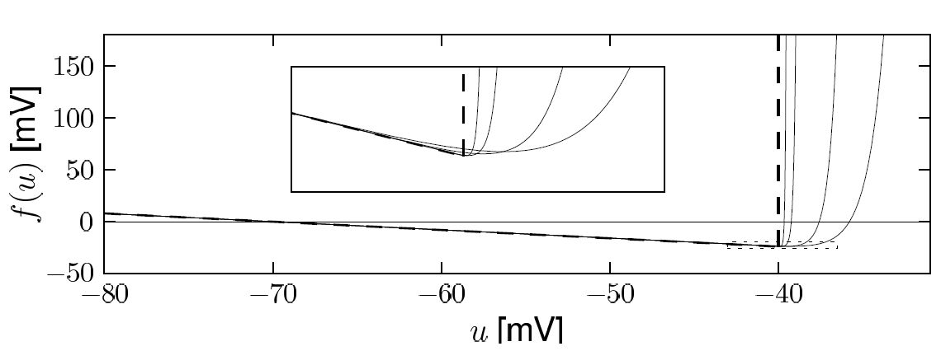
Neuronal Dynamics – 4.5. Exponential Integrate-and-Fire Model
Exponential integrate-and-fire model (EIF)
linear
Image: Neuronal Dynamics,
Gerstner et al.,
Cambridge Univ. Press (2014)

Slide 25
Neuronal Dynamics – 4.5. Exponential Integrate-and-Fire Model
Direct derivation from Hodgkin-Huxley
Fourcaud-Trocme et al, J. Neurosci. 2003
gives expon. I&F

Slide 26
Neuronal Dynamics – 4.5. Nonlinear Integrate-and-Fire Model
2-dimensional equation
Separation of time scales
w is constant (if not firing)
Relevant during spike
and downswing of AP
threshold+reset for firing

Slide 27
Neuronal Dynamics – 4.5. Nonlinear Integrate-and-Fire Model
2-dimensional equation
Separation of time scales
w is constant (if not firing)
Linear plus exponential

Slide 28
Neuronal Dynamics: Computational Neuroscience of Single Neurons
Nonlinear Integrate-and-Fire Model
Nonlinear Integrate-and-fire (NLIF)
- Definition
- quadratic and expon. IF
- Extracting NLIF model from data
- exponential Integrate-and-fire
- Extracting NLIF from detailed model
- from two to one dimension
- Quality of NLIF?
Week 1 and Week 4:
Nonlinear Integrate-and-fire Model
Wulfram Gerstner
EPFL, Lausanne, Switzerland

Slide 29
Neuronal Dynamics – 4.5 sparse activity in vivo
Spontaneous activity in vivo
awake mouse, cortex, freely whisking,
-spikes are rare events
-membrane potential fluctuates around ‘rest’
Crochet et al., 2011
Aims of Modeling: - predict spike initation times
- predict subthreshold voltage

Slide 30
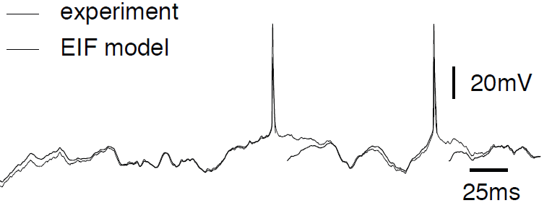
Neuronal Dynamics – 4.5.How good are integrate-and-fire models?
Badel et al., 2008
Aims: - predict spike initation times
- predict subthreshold voltage
Add adaptation and
refractoriness (week 7)

Slide 31
Neuronal Dynamics – Quiz 4.7.
Exponential integrate-and-fire model.
The model can be derived
[ ] from a 2-dimensional model, assuming that the auxiliary variable w is constant.
[ ] from the HH model, assuming that the gating variables h and n are constant.
[ ] from the HH model, assuming that the gating variables m is constant.
[ ] from the HH model, assuming that the gating variables m is instantaneous.
B. Reset.
[ ] In a 2-dimensional model, the auxiliary variable w is necessary to implement a
reset of the voltage after a spike
[ ] In a nonlinear integrate-and-fire model, the auxiliary variable w is necessary to implement a reset of the voltage after a spike
[ ] In a nonlinear integrate-and-fire model, a reset of the voltage after a spike is implemented algorithmically/explicitly

Slide 32
Neuronal Dynamics – Nonlinear Integrate-and-Fire
Reading: W. Gerstner, W.M. Kistler, R. Naud and L. Paninski,
Neuronal Dynamics: from single neurons to networks and
models of cognition. Chapter 4: Introduction. Cambridge Univ. Press, 2014
OR W. Gerstner and W.M. Kistler, Spiking Neuron Models, Ch.3. Cambridge 2002
OR J. Rinzel and G.B. Ermentrout, (1989). Analysis of neuronal excitability and oscillations. In Koch, C. Segev, I., editors, Methods in neuronal modeling. MIT Press, Cambridge, MA.
Selected references.
-Ermentrout, G. B. (1996). Type I membranes, phase resetting curves, and synchrony.
Neural Computation, 8(5):979-1001.
Fourcaud-Trocme, N., Hansel, D., van Vreeswijk, C., and Brunel, N. (2003). How spike generation mechanisms determine the neuronal response to fluctuating input.
J. Neuroscience, 23:11628-11640.
Badel, L., Lefort, S., Berger, T., Petersen, C., Gerstner, W., and Richardson, M. (2008). Biological Cybernetics, 99(4-5):361-370.
- E.M. Izhikevich, Dynamical Systems in Neuroscience, MIT Press (2007)

